Slide 1
Computer Science Education Game
MIDTERM PROJECT REPORT
Team GJC
https://github.com/JakenW/Computer-Science-Education-Game/tree/main/Midterm%20Presentation
Christina Kong (ctk2@hood.edu)
Grayson Swift (gls15@hood.edu)
Jaken Whipp (jaw32@hood.edu)

Slide 2

PROJECT DESCRIPTION
Computer Science Instructor
NPC interactions to solve logical puzzles while answering CS questions.
CS lecture after level completion

Slide 3

OBJECTIVES
Several Locations
Total of Five Days (Levels)
Encourage Computer Science Education
An Outlet to Practice CS knowledge
Resource for studying Computer Science

Slide 4

PROBLEMS TO SOLVE
Boundaries/Map Collision
Map/Location Change
Password Field and Functionality
Handling error when creating account with pre-existing name
Implementing canvas page into overall webpage

Slide 5
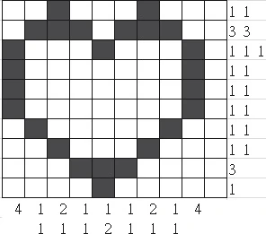
MORE PROBLEMS TO SOLVE
Recreate puzzles table in database
Implement nonogram puzzle functionality
Transition from Open World to Puzzle Interface
NPC to User Interaction
In-Game Dialogue (from Database)

Slide 6

BACKGROUND & PROJECT PLAN
Individual MERN projects: Video game information App; Todo app
Prior Flask Projects: Seivom App; Photo App
Helped facilitate original functionality
Useful references for understanding languages
Difficult to implement in this project
Originally planned for 1 level to be playable by Midterm

Slide 7
TECHNICAL DESCRIPTION
Development Stack:
Mongo (Backend), Express (Backend), React (Frontend), Node (Frontend/Backend), HTML (Frontend), CSS (Frontend), JavaScript (Frontend)
Platform/Tools:
Visual Studio Code (JavaScript, HTML, CSS)
MongoDB Atlas
Tiled

Slide 8

MORE ON TECHNICAL DESCRIPTION
Basic Functionality:
Move Around Environment
Traverse Rooms
Interact with Objects/NPCs
Play Puzzles
Retrieve and Answer Questions
Clear Levels
In-Game Dialogue
Store Player Data
Expected Features:
Upload Question Sets
Multiple Save Files
Question Difficulty Selection

Slide 9

ACCOMPLISHED WORK
Open-world Environment
Player Movement
Website for the game
User Account Creation
Question Creation

Slide 10

MORE ABOUT ACCOMPLISHED WORK
7 Component Files (Front End Functionality)
1 Server File with 2 Route Files (Back End Functionality)
2 Database Tables (Users and Questions)
3 PNGs of Game Backgrounds
Some aspects of the code are not fully fleshed out
Basic functionality exists

Slide 11
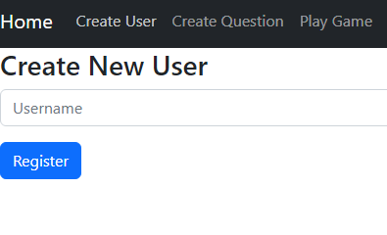
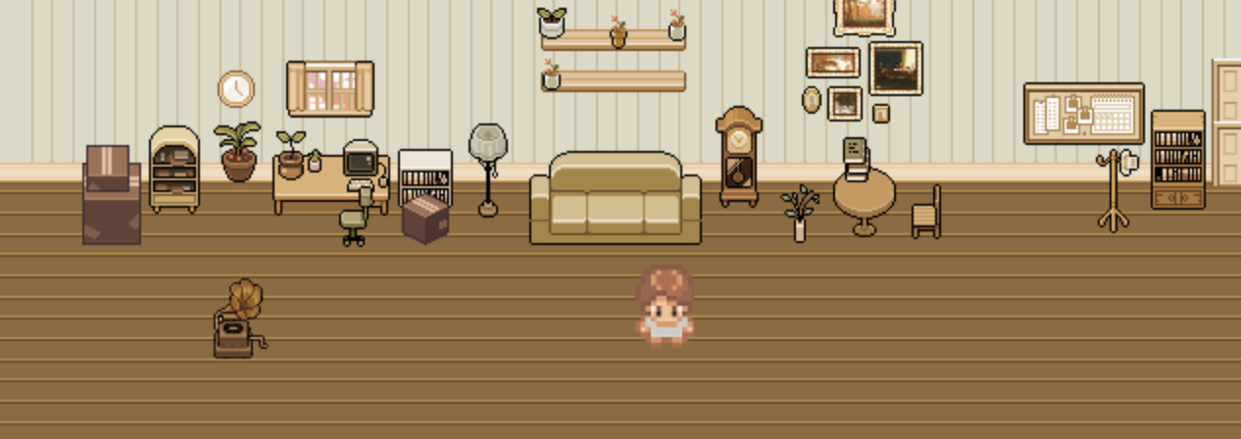
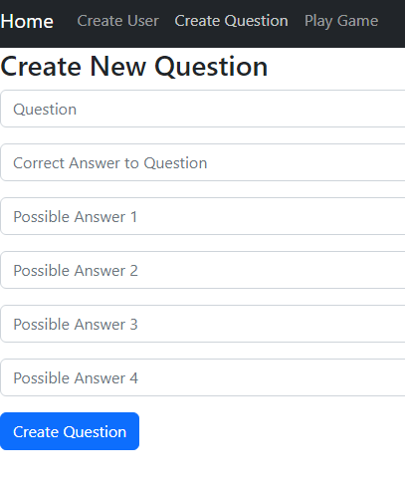
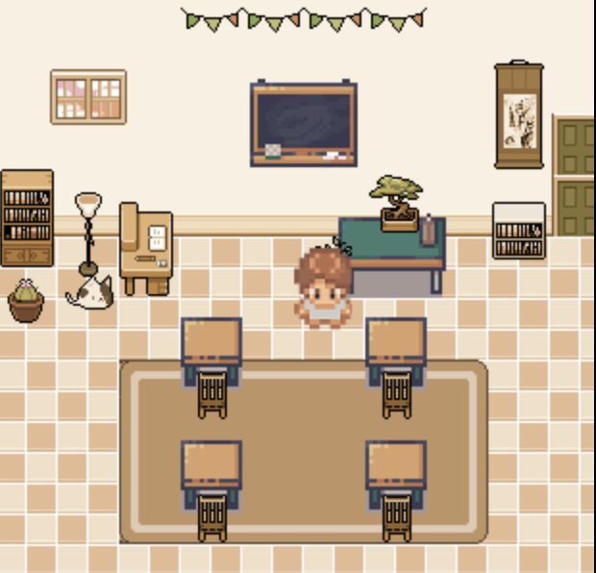
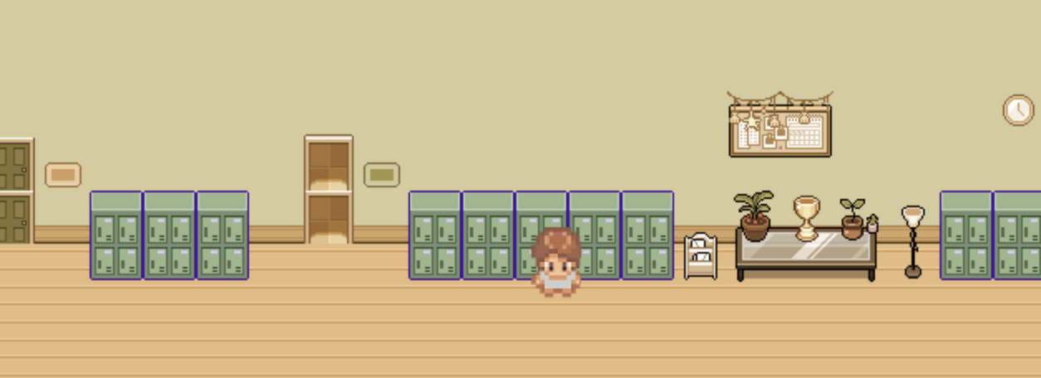
STATUS

Slide 12
EFFORT
Group Member | Roles | Hours Spent
Jaken Whipp | Creating db tables Connect frontend and backend Create functionality | 10.5 hours
Christina Kong | Frontend/Website Designer Game Art/Assets | 7 hours
Grayson Swift | Game Environment Designer | 8 hours

Slide 13






Group Meetings
Weekly/Daily Tasks
Github/Group Server

Slide 14
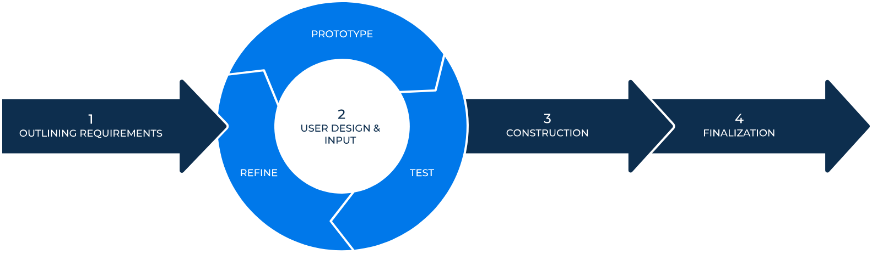
METHODOLOGY
Rapid development… but why?
Flexible and quick approach
Better risk management/control
Good Client and Business involvement
Effectively adapts to change
Facilitated the Flask to MERN swap

Slide 15
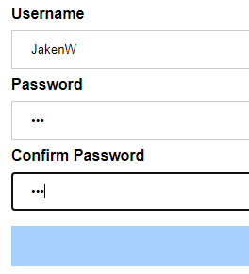
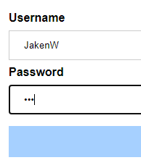




LESSONS LEARNED
Flask alongside Canvas is Complicated
Difficulties accessing images within script file when using Flask
Flask is rigid with accessing files (src = "{{url_for('static', filename='name')}}")
Troubleshooting image file locations through Flask proved difficult
Influenced swap from Flask to MERN

Slide 16

MORE LESSONS LEARNED
Working Independently Can be Confusing
Tasks conducted by others can be difficult to understand and operate on without context.
Use of different languages for differing aspects contributed to confusion due to inexperience with languages.
Using the same sources and tutorials can help grow comprehension.

Slide 17

MORE LESSONS LEARNED
Combining Aspects can be Challenging
The way of handling things within dependencies is different than expected
Contributes to longer time spend troubleshooting merging pieces
Figuring out how different dependencies interact prior to solidifying their use should help decrease this issue

Slide 18
EXPECTED FORTHCOMING ACTIVITIES
Group Member | Activities | Deadlines
Jaken Whipp | Implementation of puzzles Account verification DB data to Frontend | Everything by May 1st Combine Aspects by May 11th
Grayson Swift | Establish final game map Create transitions between scenes Bug test character interaction | Want to get all the map done by by the first week of May Transitions should be done by beginning of April Bug testing will be intermittent
Christina Kong | In-game Dialogue Character Portraits Background Art Finalizing the Game’s Website | In-Game Dialogue - By April 24th Character Portraits/Background Art - By May 1st Finalizing the Game’s Website - By May 11th
The Team | Script for CS Lessons | April 24th

